Slide 1

Walk with Wakki
Nate Ackermann, Nadia Asif, Polly Bainbridge, Calvin Lin, Sarem Rashid

Slide 2
App Overview
Target Market: The elderly and obese population within the United States
The United States Population has been shifting to include a much larger elderly population.
“Obesity rates among older adults have been increasing, standing at about 40 percent of 65-to-74-year-olds in 2009-2012”
App Functionality: “Walking with Wakki” is a google maps integrated application encouraging users to walk greater distances in their day-to-day life through the facade of taking care of the virtual pet, Wakki.
Future Goals:
Introduce an iterative approach to increasing distance walked on app by prompting the user to walk a certain distance further after each week of app use
Back End: Code would generate a longer route via Google Maps
Front End: User is given motivation for the longer walk as their pet wants to "play somewhere new" or "try a new food."
Mather, Mark. “Fact Sheet: Aging in the United States.” PRB, Population Reference Bureau, Jan. 2016, www.prb.org/Publications/Media-Guides/2016/aging-unitedstates-fact-sheet.aspx.

Slide 3
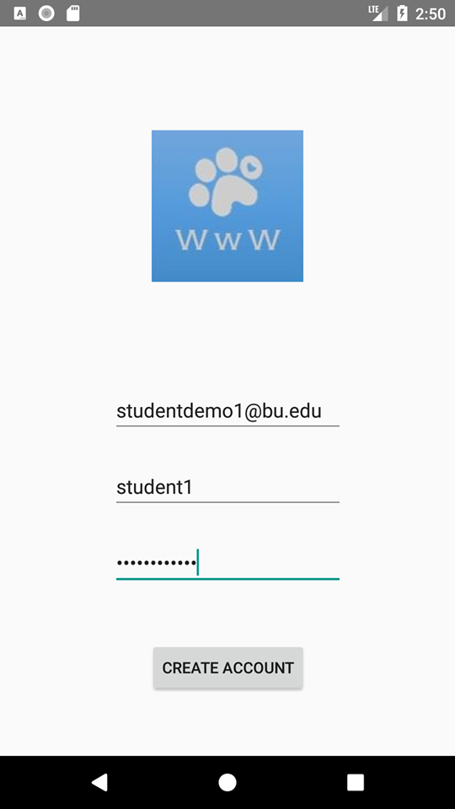
CreateAccount
Front End Functionality:
This is the “Login Screen”
Prompts user to create an account by prompting asking the user to provide an email address, username, and password. These are the “Login Values”
Back End Functionality:
The Login Values are then stored into the Firebase Database.

Slide 4
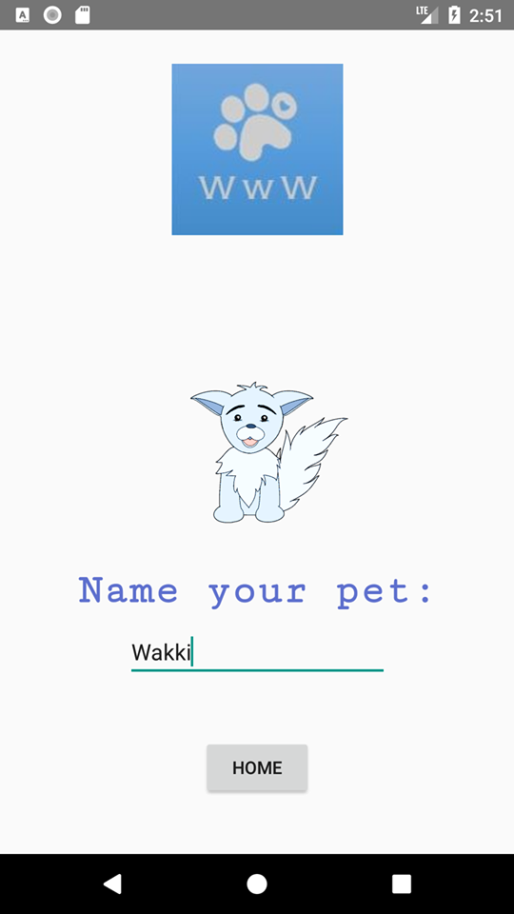
NamePet
Front End Functionality:
This is the “Name Pet Screen”
After creating an account, the app then prompts the user to name their “Pet” to finalize their profile.
Clicking “Home” will take the user to the “Home Screen”
Back End Functionality:
The Pet’s name is stored in the FireBase database when the user clicks the Home button.

Slide 5
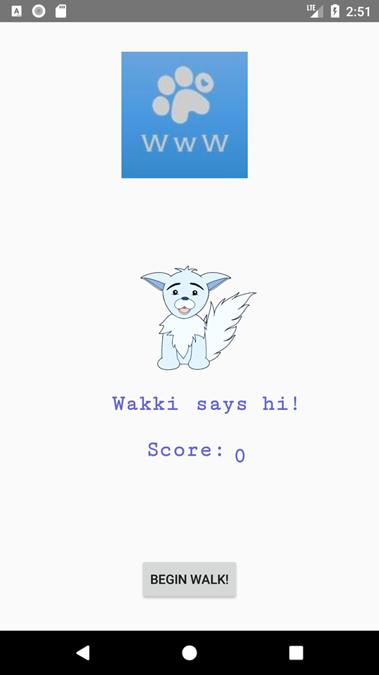
PlanWorkout
Front End Functionality:
This is the “Home Screen”
Displays logo, Pet, the Pet’s name, and a button that prompts the user to plan their workout and begin their walk
Back End Functionality:
The “Begin Walk” button, initiates the Maps functionality

Slide 6
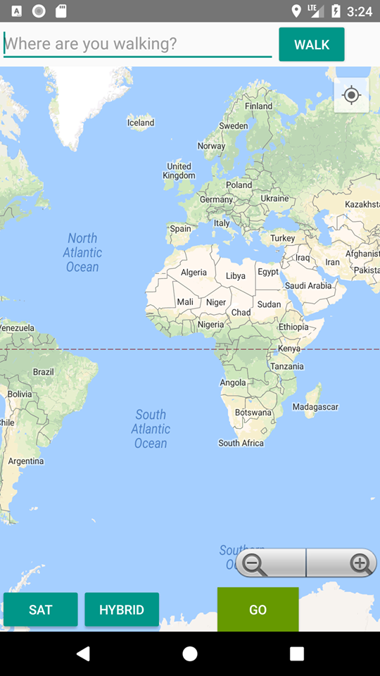
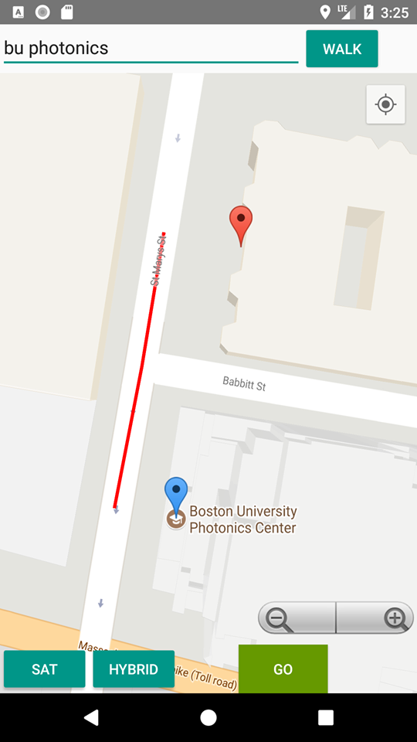
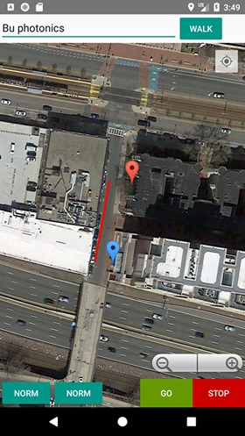
MapsActivity
Front End Functionality:
(Fig. 1) Prompts user to input the “Start” (blue marker in Fig. 2) and “Finish” (red maker in Fig. 2) points of their desired route for their “Workout Plan”
Pushing “GO” (Fig. 2) initiates the walk and makes the “STOP” button appear (Fig 3)
“SAT” toggles between maps (Fig. 2) and satellite view (Fig. 3) of the created route
Clicking the “STOP” takes the user to the “Walk Success Screen”
Fig. 1
Fig. 2
Fig. 3

Slide 7
MapsActivity
Back End Functionality:
MapsActivity implements 3 different APIs by Google:
Maps
Places
Directions
Additionally, MapsActivity implements one of Android’s API Classes: LocationManager
The getLocation() function uses GPS functionality within LocationManager to return coordinates (longitude and latitude) of the “Start” marker
Places API matches user input string to coordinates of the “Finish” marker
Fig. 1
Fig. 2
Fig. 3

Slide 8
MapsActivity
Back End Functionality:
The “Walk” Button calls the Directions API, inputting the coordinates of the “Start” and “Finish” markers, to generate the walking route
Clicking “GO” makes the “STOP” button appear and calls a function that calculates the distance between the “Start” and “Finish” markers
The distance is used to calculate the user’s XP gained from their workout
This XP is then added to the user’s current XP (displayed on the “Home Screen”) by updating the FireBase Database
Fig. 1
Fig. 2
Fig. 3

Slide 9
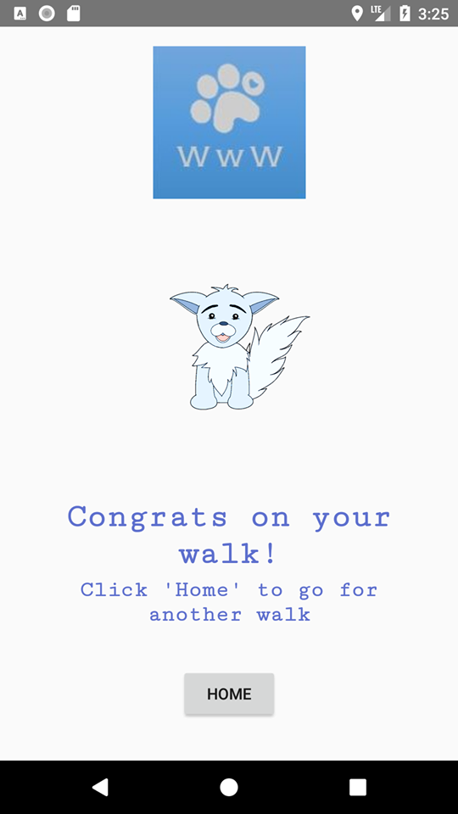
WalkSuccess
Front End Functionality:
Displays a message congratulating the user for completing their workout
“HOME” button takes user to “Home Screen”

Slide 10
End Walk (STOP)
Start Walk (GO)
Zoom In/Out (+/-)
Google Maps API
Satellite View (SAT)
Opens map interface
Hybrid View (HYBRID)
GPS (getLocation)
Google Map Places API
MapsActivity
GPS LocationManager
Returns geolocation of “Finish” marker
Google Map Directions API
Data Parser
Returns shortest walking route
Converts JSON Object to Polyline Route
Notes:
COLOR CODE
RED → CLASSES BLUE → SERVICES
GREEN → BUTTON FEATURES
GREY >> ACTION/RETURN VALUE
YELLOW >> BTN

Slide 11
User inputs username, email, password
NO
YES
Go to CreateAccount, prompt for login credentials
Is this a known user?
Get authSuccess object from Firebase
Success?
YES
New user signed in
NO
Print error message
Read/write access granted to user
Database updated
App + Firebase
Workflow
Get reference to database in ‘Activity X’
read/write to database

Slide 12
User’s score calculated, pet score (XP) added to database
New user credentials sent to database
Firebase Database
User created and signed in
PetName field updated
Pet’s name fetched and displayed
Most recent score fetched and displayed
CreateAccount
NamePet
PlanWorkout
MapsActivity
WalkSuccess

